Slide 1
Barangay System
Group Members
Kamila Lagman Christian Ansel Sevilla David Warren Arcellana Jhonel Deluna

Slide 2
Target Audience
Our focused users will be the barangay citizens and officials. Helping them in managing and securing their own records.

Slide 3
General Objectives
Create organized and secured information details for the barangay citizen to provide fast and accurate transactions. Help lessen complications such as information redundancy caused by repetitive registration and avoid missing data thus leading to successful document processes.
Educate the citizens by providing them with appropriate content of information and giving them easy access to this information.

Slide 4
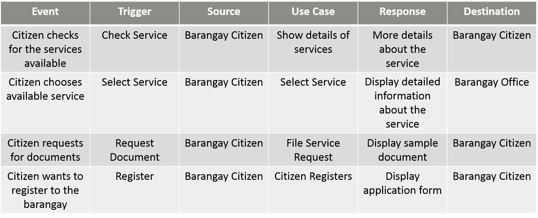
Event Table
Citizen

Slide 5
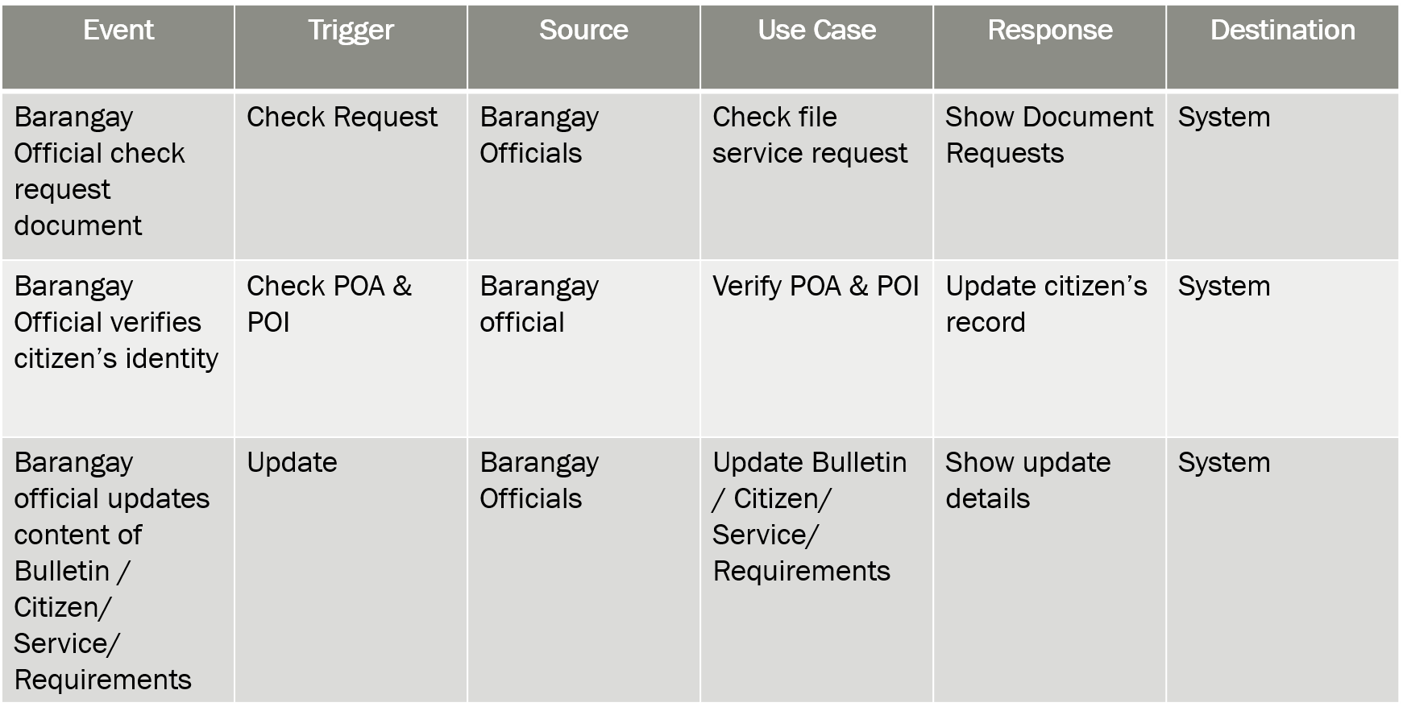
Official

Slide 6
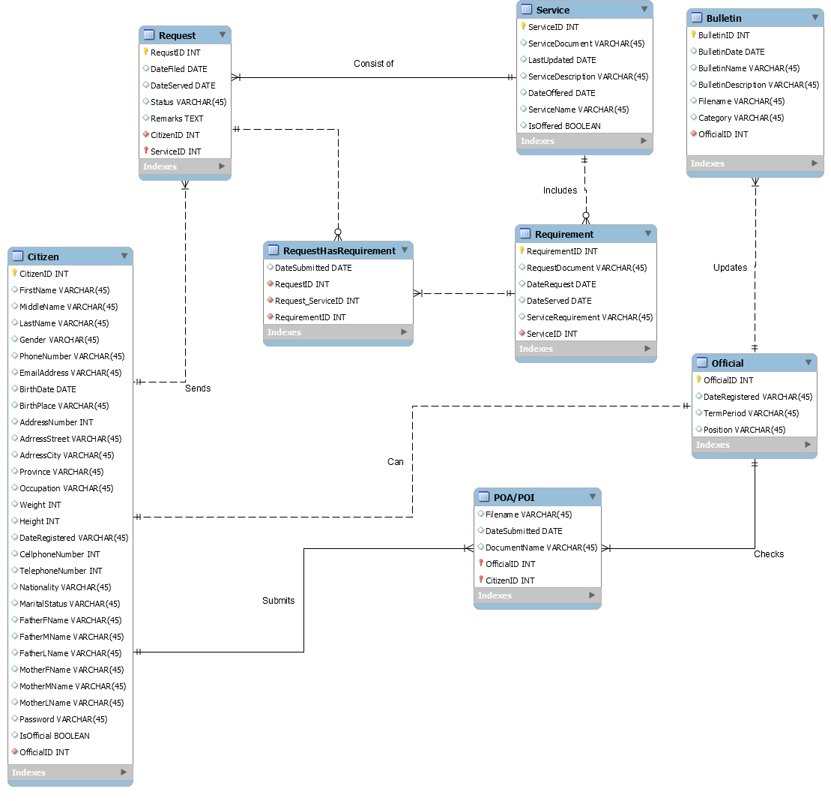
Entity Relationship Diagram

Slide 7
Diagrams

Slide 8
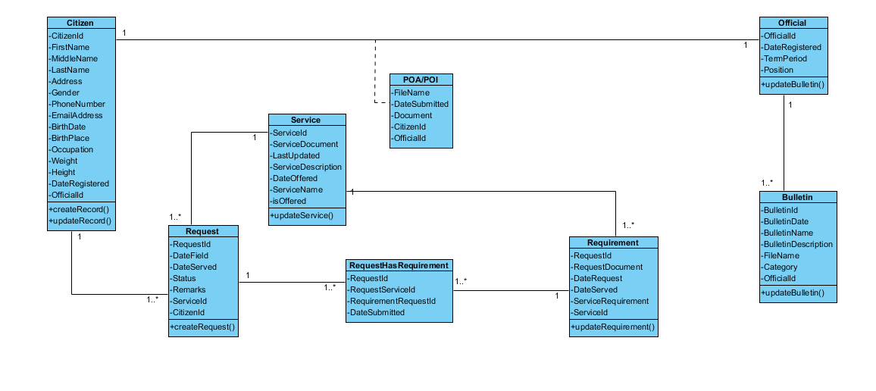
Class Diagram

Slide 9
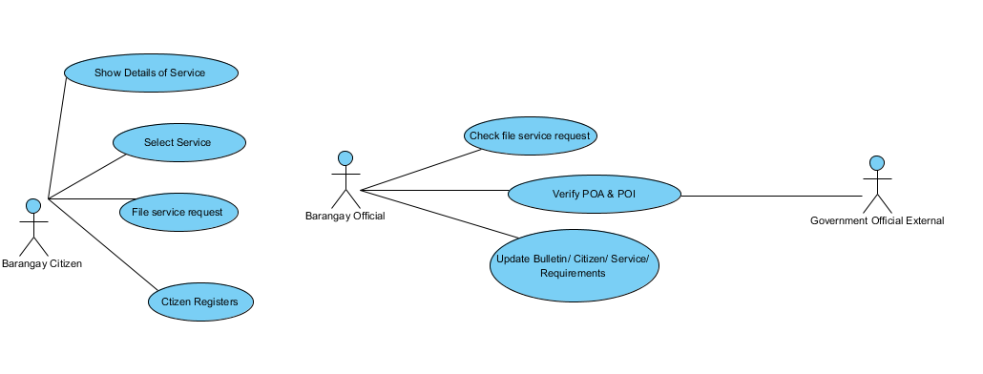
Use Case Diagram

Slide 10
Activity Diagram

Slide 11
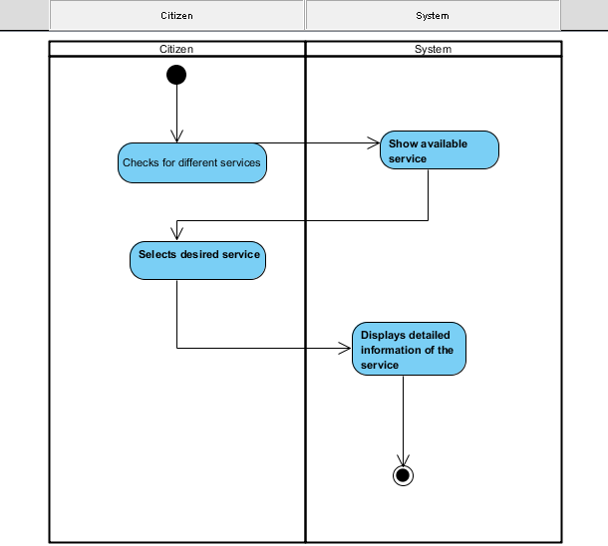
Select Service

Slide 12
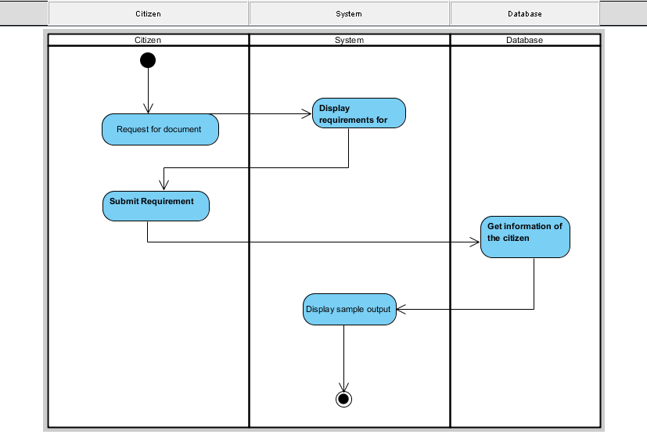
File Service Request

Slide 13
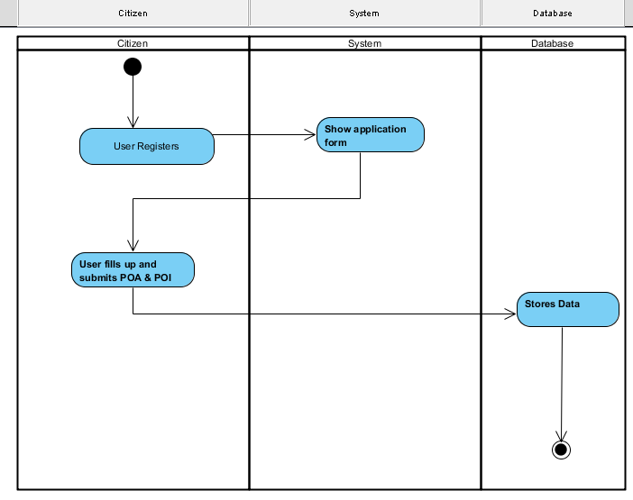
Citizen Registers

Slide 14
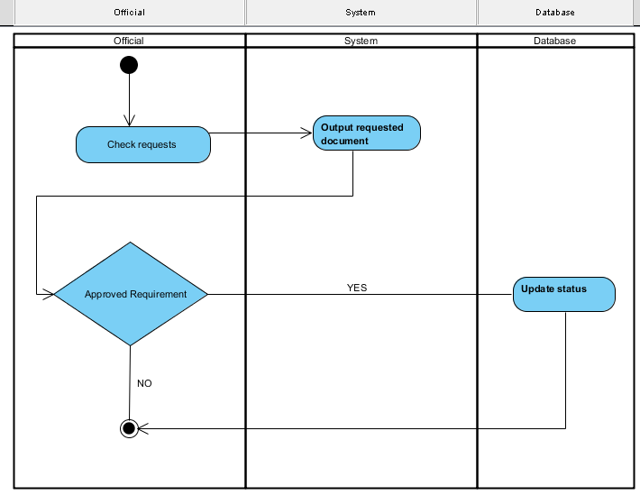
Check file service request

Slide 15
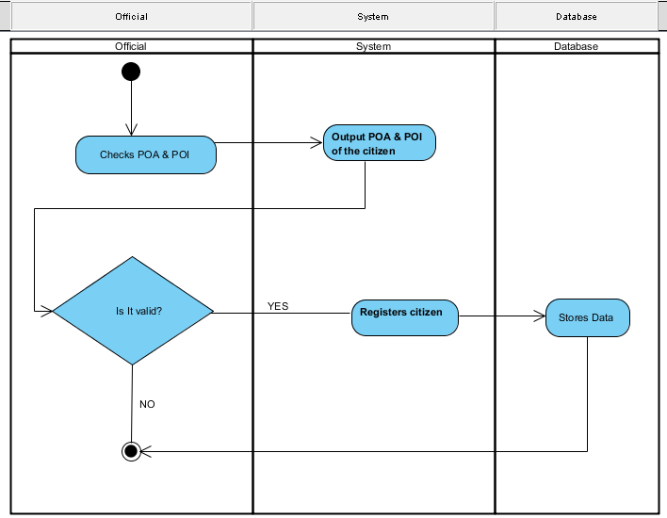
Verify Proof of Identity / Address (POI / POA)

Slide 16
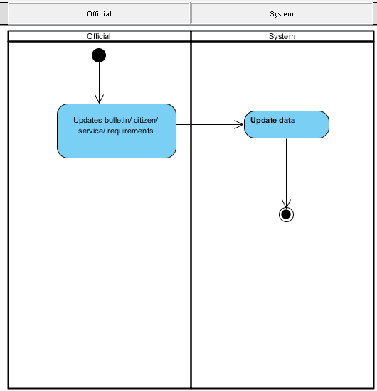
Update Bulletin

Slide 17
Sequence Diagram

Slide 18
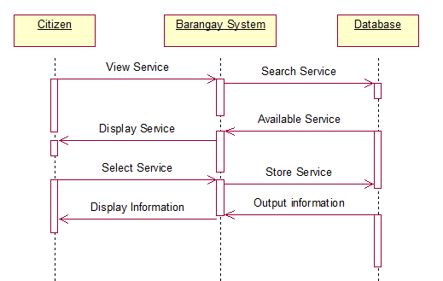
Select Service

Slide 19
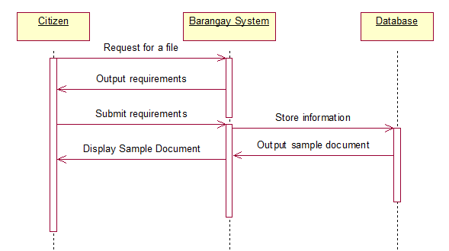
File Service Request

Slide 20
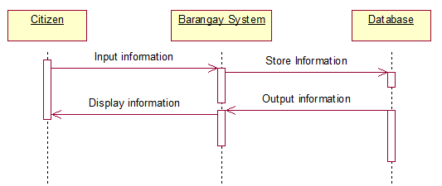
Citizen Registers

Slide 21
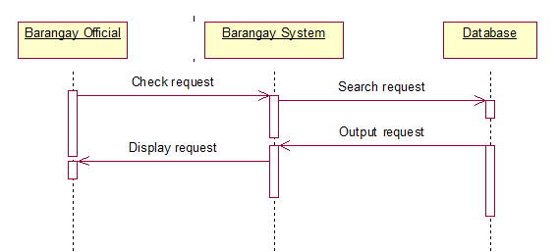
Check file service request

Slide 22
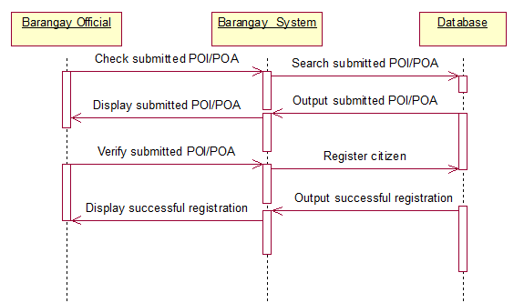
Verify Proof of Identity / Address (POI / POA)

Slide 23
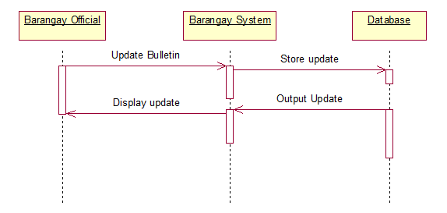
Update Bulletin

Slide 24
Collaboration Diagram

Slide 25
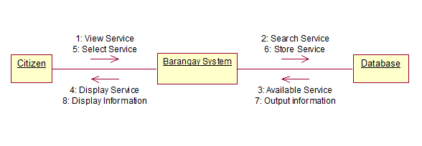
Select Service

Slide 26
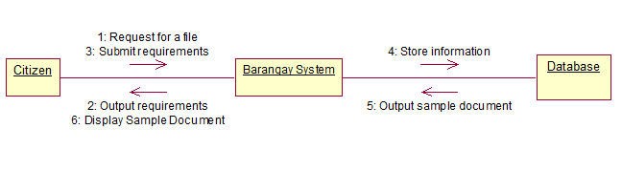
File Service Request

Slide 27
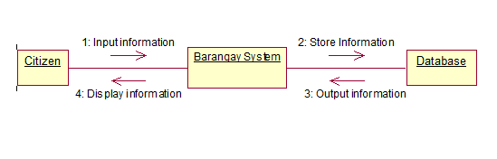
Citizen Registers

Slide 28
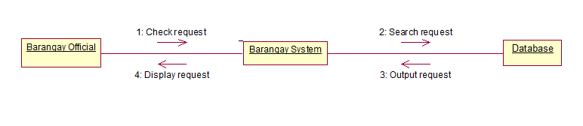
Check file service request

Slide 29
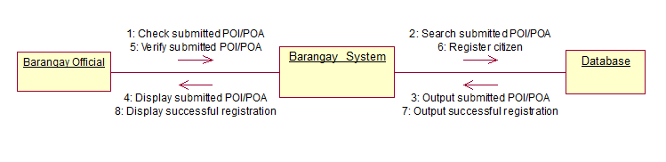
Verify Proof of Identity / Address (POI / POA)

Slide 30
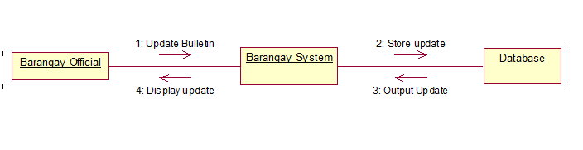
Update Bulletin

Slide 31
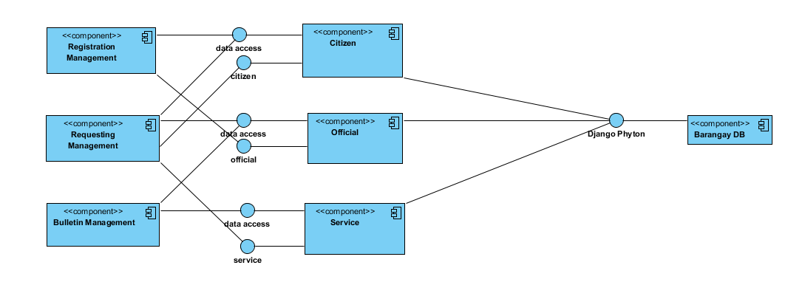
Component Diagram

Slide 32
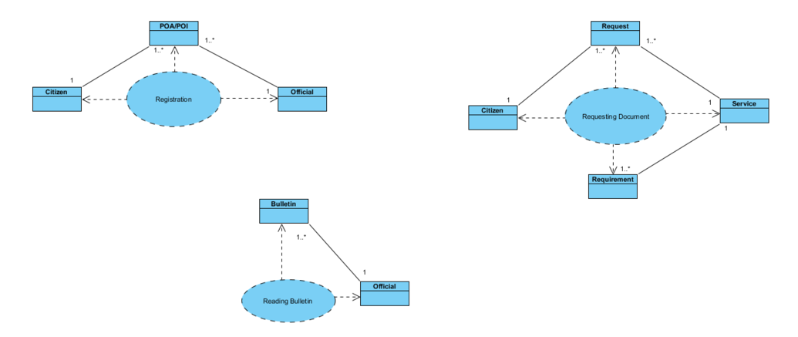
Composite Diagram

Slide 33
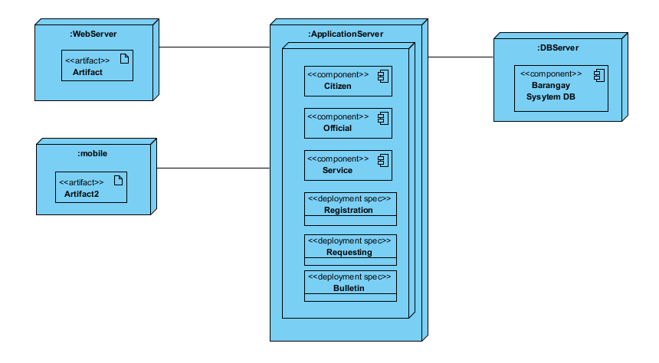
Deployment Diagram

Slide 34
Interaction Diagram

Slide 35
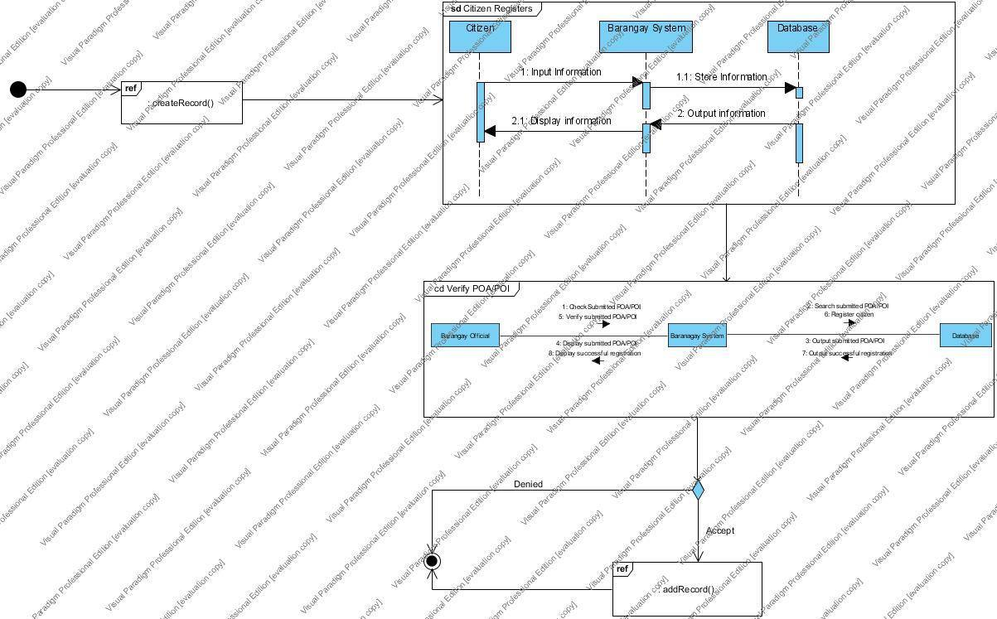
Citizen Registers

Slide 36
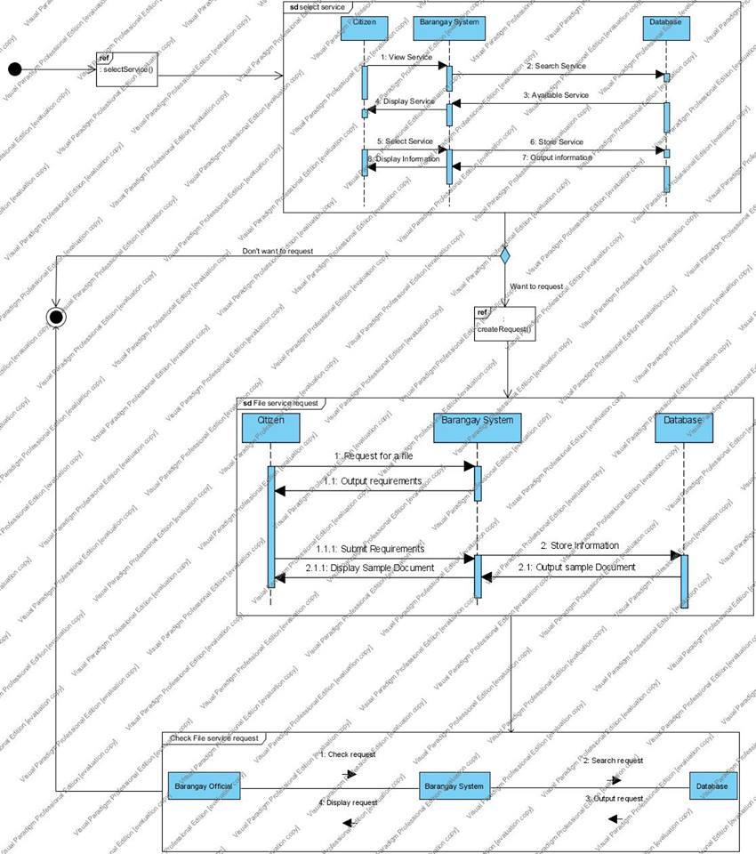
Request Document

Slide 37
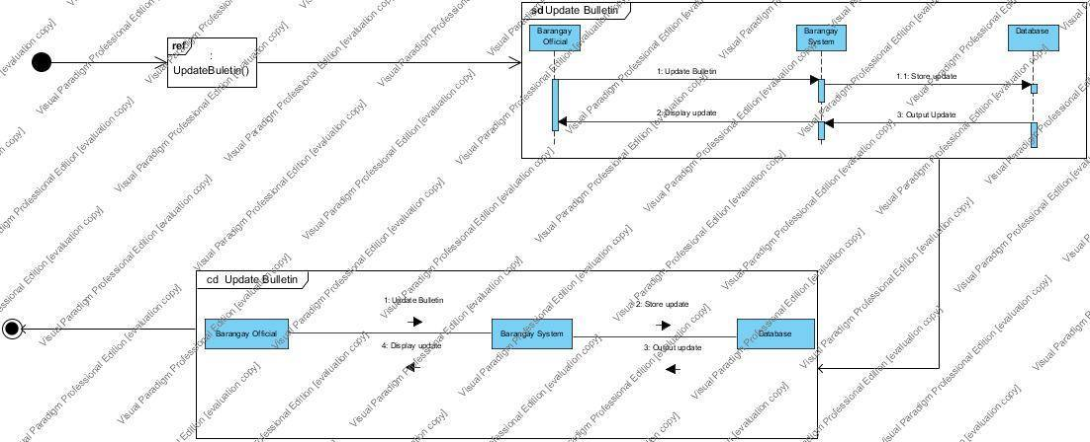
Update Bulletin

Slide 38
Package Diagram

Slide 39
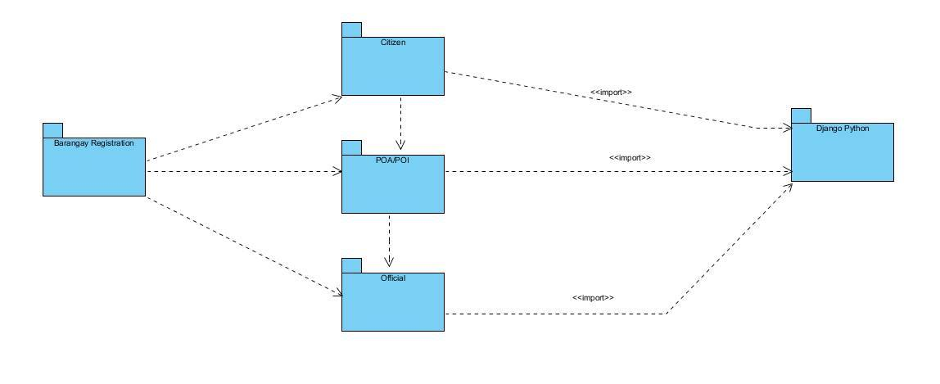
Citizen Registers

Slide 40
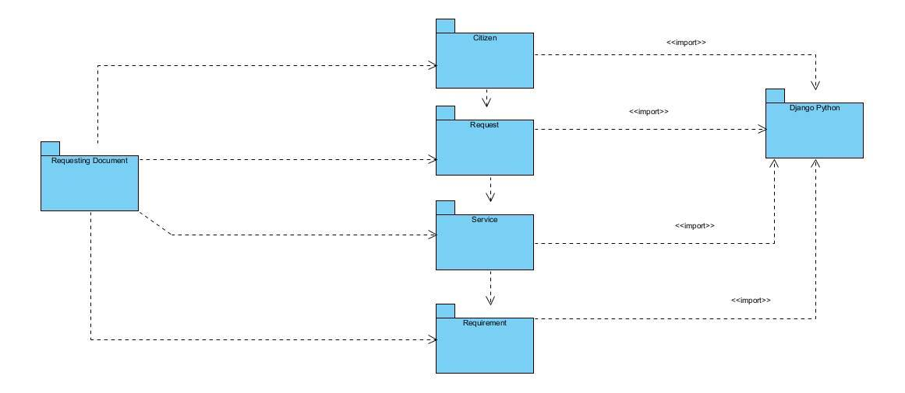
Request Document

Slide 41
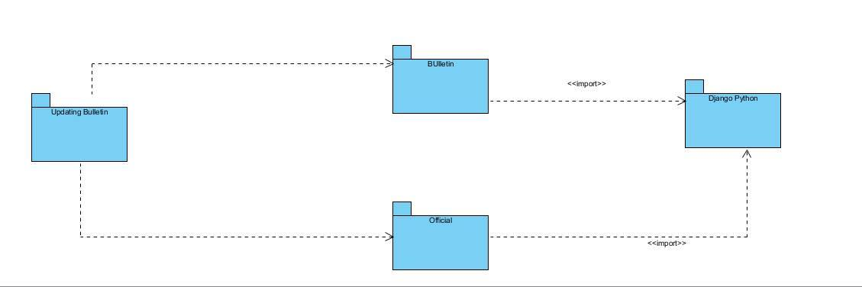
Update Bulletin

Slide 42
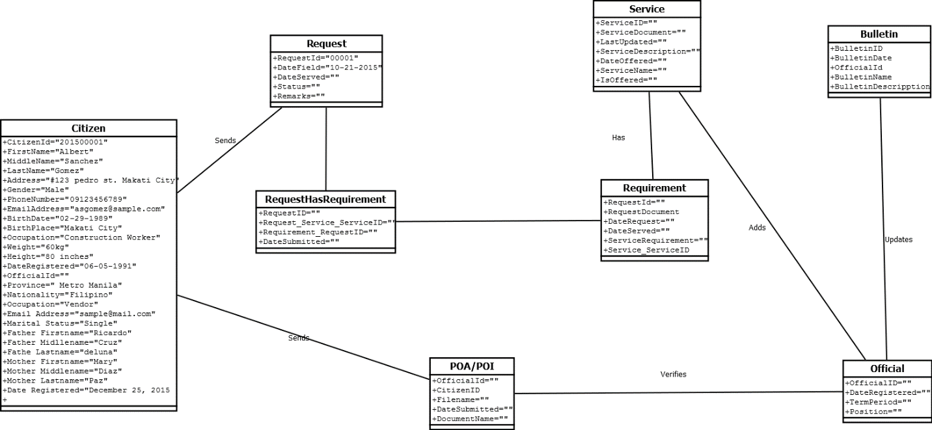
Object Diagram

Slide 43
State Machine Diagram

Slide 44
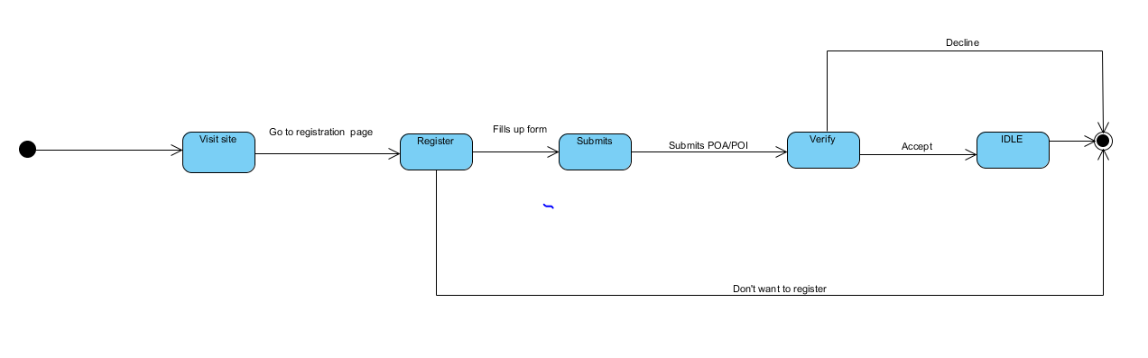
Citizen Register

Slide 45
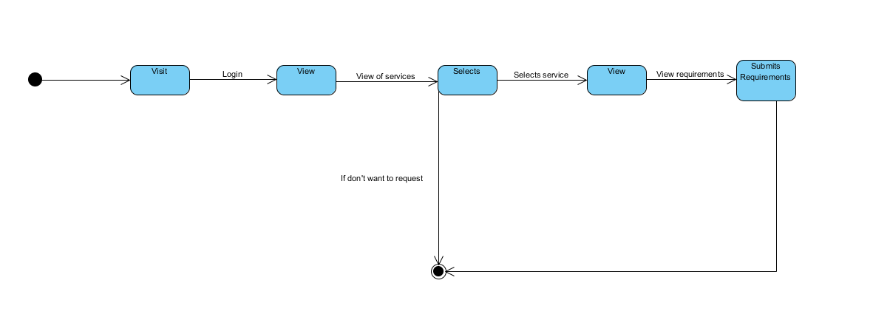
Request Document

Slide 46
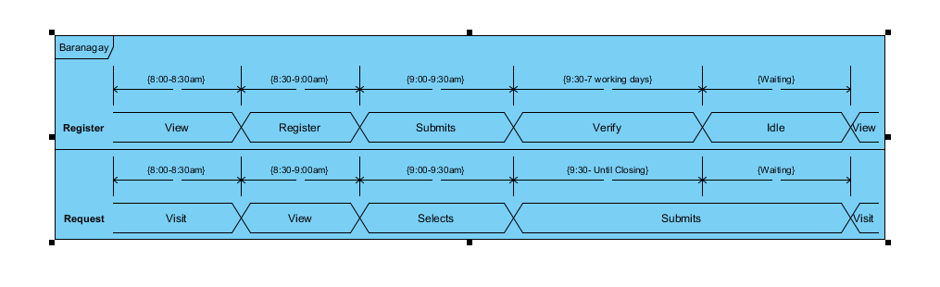
Timing Diagram

